Slide 1


Dept of AIML

Slide 2
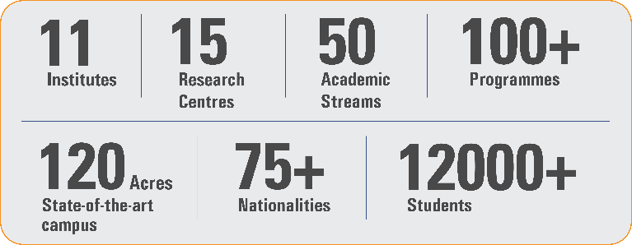
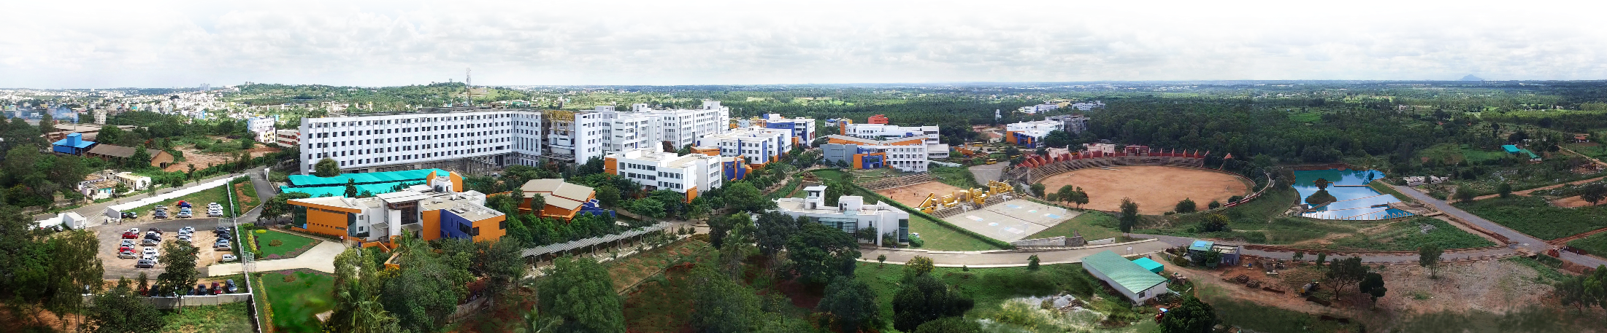
Overveiw
Acharya stands as a beacon of excellence in higher education, boasting a legacy of academic distinction since its establishment in 1990. We offer a transformative educational experience, fostering holistic development, nurturing innovation and providing world-class facilities to ensure an enriching journey for our students.
Dept of AIML

Slide 3
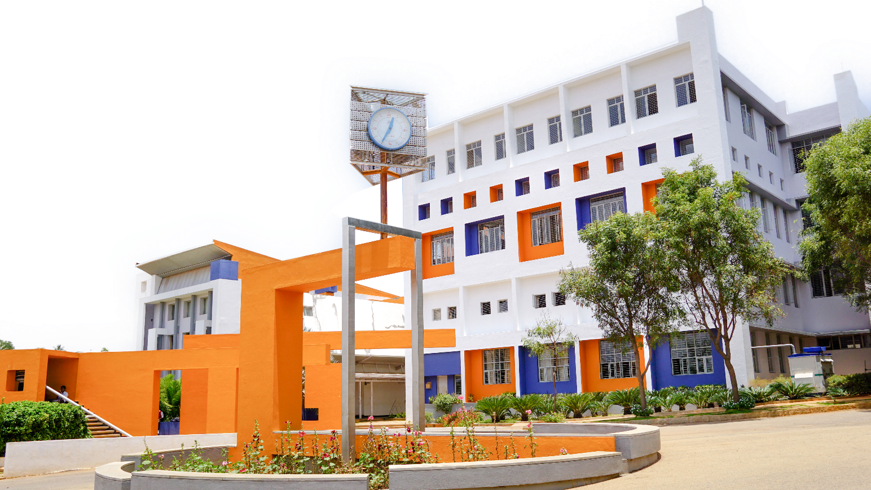
11 Institutions, Infinite Possibilities
We provide 100+ programs across 50 academic streams.
Dept of AIML

Slide 4
TopicName
PresentedBy
USN
Dept of AIML

Slide 5
Heading
Important
Make the first slide a Table of Contents
Each slide must use the same template.
Don’t add too much content per slide.
Write the content in points.
Make heading as 40, Bold, Times New Roman; sub heading as 24, Bold, Times New Roman and rest of the content as as 40, Times New Roman.
Alignment must be Justified.
Use your creativity for better presentation.
Dept of AIML

